Slide 1
Introduction to Computer System

Slide 2
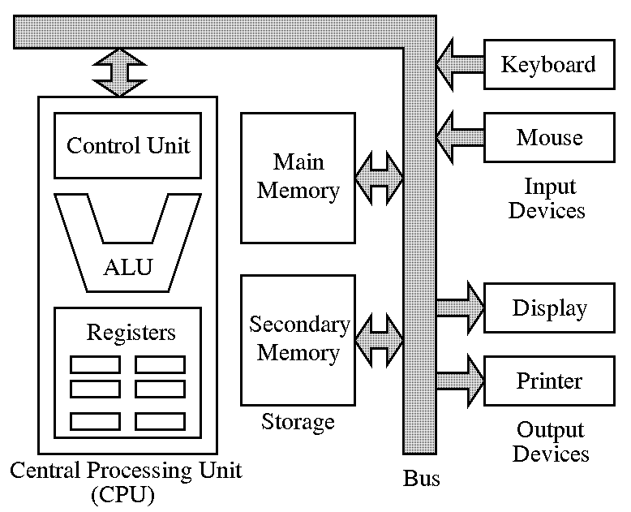
Computer Architecture

Slide 3
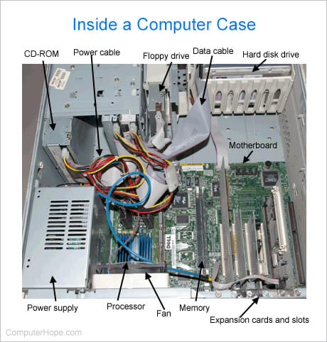

Slide 4
Hardware
Computer hardware is the collection of physical elements that constitutes a computer system.
Example: monitor, mouse, keyboard, computer data storage, hard drive disk (HDD), system unit (graphic cards, sound cards, memory, motherboard and chips), etc. all of which are physical objects that can be touched.

Slide 5
Software
Computer software, or simply software, also known as computer programs, is the non-tangible component of computers.
It represents the set of programs that govern the operation of a computer system and make the hardware run.
Computer software contrasts with computer hardware, which is the physical component of computers.
One major example is operating system. All computers require an operating system. E.g. DOS ( Disk operating System), Windows, Linux, Mac etc.

Slide 6
Types of Software
System Software
To control operation and extend the processing capabilities of computer system.
e.g. Operating System, Compiler, Assembler, etc.
Application Software
Designed for user specific need.
General purpose
e.g. MS Office, Excel etc.
Specific purpose
Custom built according to requirement of user.

Slide 7
System Software
Operating System
Compiler : translates high level language to object code
Assembler : translates assembly to machine language
Loader : which loads OS part and object program into main memory for execution purpose. E.g. bootstrap loader.
Linker : which binds code of source and library file to make executable programs.
Editor : used to write a program.
Translator : which converts one language into other. (Compiler, Assembler, Interpreter)
Macro processor : Replace symbolic meaning into equivalent code. Also, called pre-processor.
Interpreter : translates line by line high level language into machine language.

Slide 8
Input Devices
Accept data and instructions from the user or from another computer system.
Example: Keyboard, Mouse, Scanner, Mike

Slide 9
Output Devices
Return Processed data back to the user or other computer system
Example: Printer, Monitor, Speaker

Slide 10
Central Processing Unit (CPU)
A central processing unit (CPU) is the hardware within a computer that carries out the instructions of a computer program by performing the basic arithmetical, logical, and input/output operations of the system.
CPU is a combination of ALU (arithmetic logic unit) and CU (Control Unit).
ALU
It performs all arithmetic calculations and takes logical decision.
CU
It manages and coordinates operations of all other components of computer system.
It tells the computer's memory, arithmetic and logic unit and input and output devices how to respond to the instructions that have been sent to the processor.

Slide 11
Bus and System Bus
In computer architecture, a bus is a communication system that transfers data between components inside a computer, or between computers.
This expression covers all related hardware components (wire, optical fiber, etc.) and software, including communication protocols.
Can be parallel or serial.

Slide 12
Register
Registers are a type of computer memory used to quickly accept, store, and transfer data and instructions that are being used immediately by the CPU. The registers used by the CPU are often termed as Processor registers.
A processor register may hold an instruction, a storage address, or any data (such as bit sequence or individual characters).
The computer needs processor registers for manipulating data and a register for holding a memory address. The register holding the memory location is used to calculate the address of the next instruction after the execution of the current instruction is completed.

Slide 13
Types of Registers
Register | Symbol | Number of Bits | Function
Data register | DR | 16 | Holds memory operand
Address register | AR | 12 | Holds address for the memory
Accumulator | AC | 16 | Processor register
Instruction register | IR | 16 | Holds instruction code
Program counter | PC | 12 | Holds address of the instruction
Temporary register | TR | 16 | Holds temporary data
Input register | INPR | 8 | Carries input character
Output register | OUTR | 8 | Carries output character

Slide 14
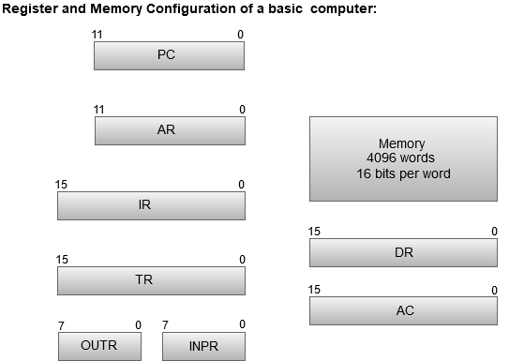

Slide 15
Memory Unit
Storage unit for processing data and information.
Holds instructions and data needed for programs that are currently running
Two types of storage:
Primary/Main storage
Secondary storage

Slide 16
Classification of Main Memory
Random Access Memory (RAM)
Stores current program or data.
Stores temporary data of current program.
Less space in comparison to secondary storage.
Volatile (data losses on power off)
Comparatively more expensive.
Fast in operation.
2. Read Only Memory (ROM)

Slide 17
Read only Memory(ROM)
ROM is used for storing programs that are PERMANENTLY resident in the computer. The ROM portion of main memory is needed for storing an initial program called bootstrap loader, witch is to start the computer software operating when power is turned on

Slide 18
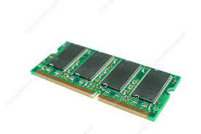
RAM Chip

Slide 19
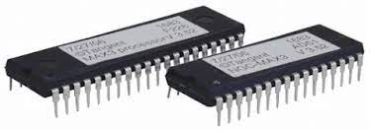
ROM Chip

Slide 20
Secondary Memory
A nonvolatile storage medium
Contents retained while power is off
Hard disk drives are most common
Records data magnetically on a circular disk
Provides fast access to large amounts of data
USB flash memory devices
High capacity device plugs into USB port
Portable, reliable, and fits easily in a pocket
e.g. Hard disk (HDD), CD, DVD, Pen Drive, Removable hard disk

Slide 21
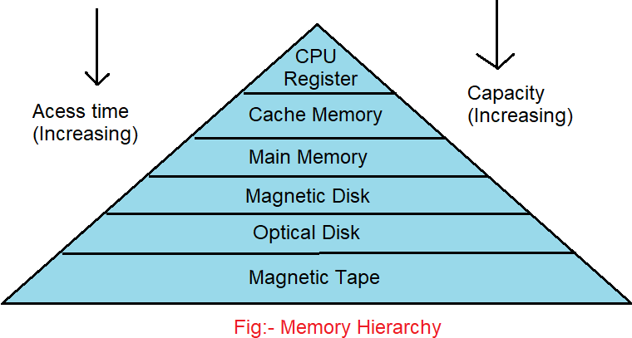
Memory Hierarchy

Slide 22
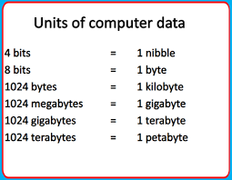

Slide 23
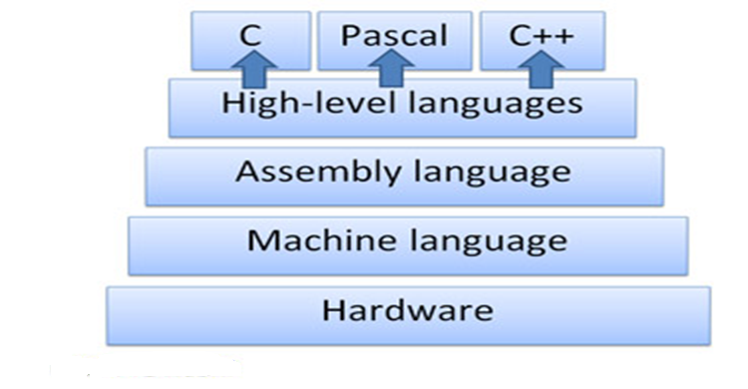
Classification of programming languages
Machine or Low level language
Assembly language
High level language
Note: Refer the document “Classification of Programming Languages”.

Slide 24
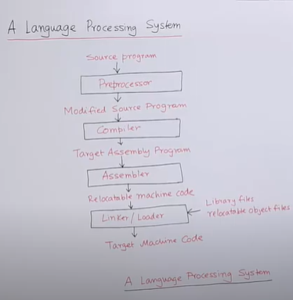
A Language processing System
Pre-processor
Source program might be taking help from other program, other modules, residing outside, that's why first handled by pre-processor, which will import or include other program ,
or program segment or program module, to have
complete environment so that program can run,
Expand some shorthand's: macros
Pre-processor convert program in different source program
In c Language # is pre-processor,
Compiler:
Translate source program to assembly language
Program, so that it become easy to debug
Different Software

Slide 25
A Language processing System
Linker :
Linker will link each and every module of program to other module Whose definition are written outside
So that program become ultimately an executable one. It also create header to the target program so that loader can easily
load front the address given in the header
When the program is asked for the execution
Loader will check free memory block or holes where it can load the program. And can have its smooth execution.
M/C code is platform dependant depending upon underlying architecture and OS Code is generated
Different Software

Slide 26
Summary of characteristics of languages
Sr. No | Language | Characteristics
1. | Machine Language | Machine dependent Represented as 0s and 1s.
2. | Assembly Language | Machine dependent Uses mnemonics 1 to 1 language i.e. for assembly language instruction generated
3. | High-level Language | Machine independent Uses instructions which seem English – like. 1 to many language i.e. for high level instruction, many machine language generated (OS specific).

Slide 27
Compiler
Compiler is a computer program (or set of programs) that transforms source code written in a programming language (the source language) into another computer language (the target language, often having a binary form known as object code). The most common reason for wanting to transform source code is to create an executable program.
The name "compiler" is primarily used for programs that translate source code from a high-level programming language to a lower level language (e.g., assembly language or machine code).
If the compiled program can run on a computer whose CPU or operating system is different from the one on which the compiler runs, the compiler is known as a cross-compiler.
A program that translates from a low level language to a higher level one is a decompiler.
A program that translates between high-level languages is usually called a source-to-source compiler.

Slide 28
Interpreter
A translating program that translates and executes the statements in sequence
Assembler or compiler produce machine code as output, which is then executed in a separate step i.e. translates line by line conversion of high level language into low level programs.
An interpreter translates a statement and then immediately executes the statement
Interpreters can be viewed as simulators

Slide 29
Assembler
An assembler is a program that takes basic computer instructions (assembly language) and converts them into a pattern of bits (machine language) that the computer's processor can use to perform its basic operations.
e.g. Microprocessor 8085, 8088.
Instruction: ADD R1, R2
Note: Refer the document “compiler_assembler_linker_loader”.

Slide 30
Compiler vs. Interpreter
Sr. No. | Particular | Compiler | Interpreter
1. | Scheme | Compiler scans the whole program at a time and lists out error if any. | Interpreter scans the program line by line and stop scanning whenever error occurs.
2. | Manner | Compiler converts the whole source code into object code at a time. | Interpreter converts the source programs.
3. | Source Code | After compilation, source code is not required. | For every execution run, source is required.
4. | Speed | Execution is faster | Execution is slower.
5. | Object Code | The object code is generated when the program is error free. | Generates object code for each line immediately if it is error free.
6. | Memory | Requires more memory. | Requires less memory.

Slide 31
Thank you

